Slide 1
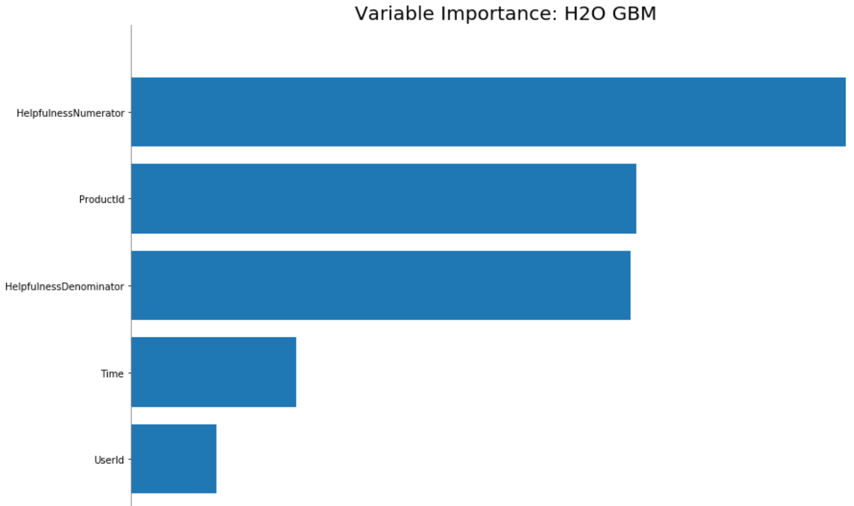
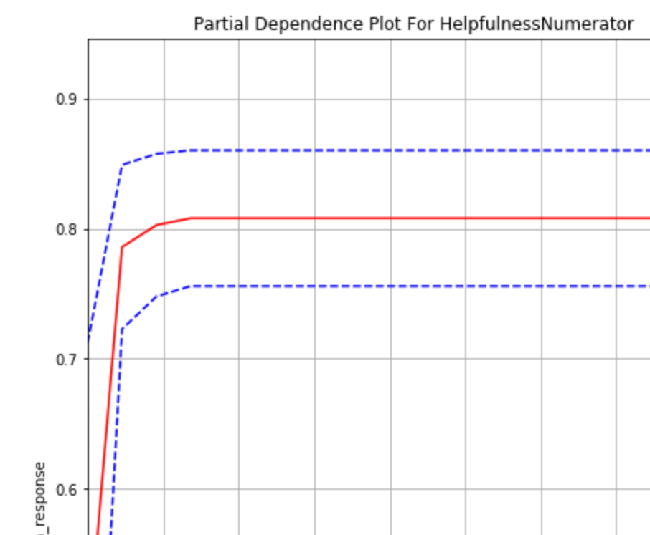
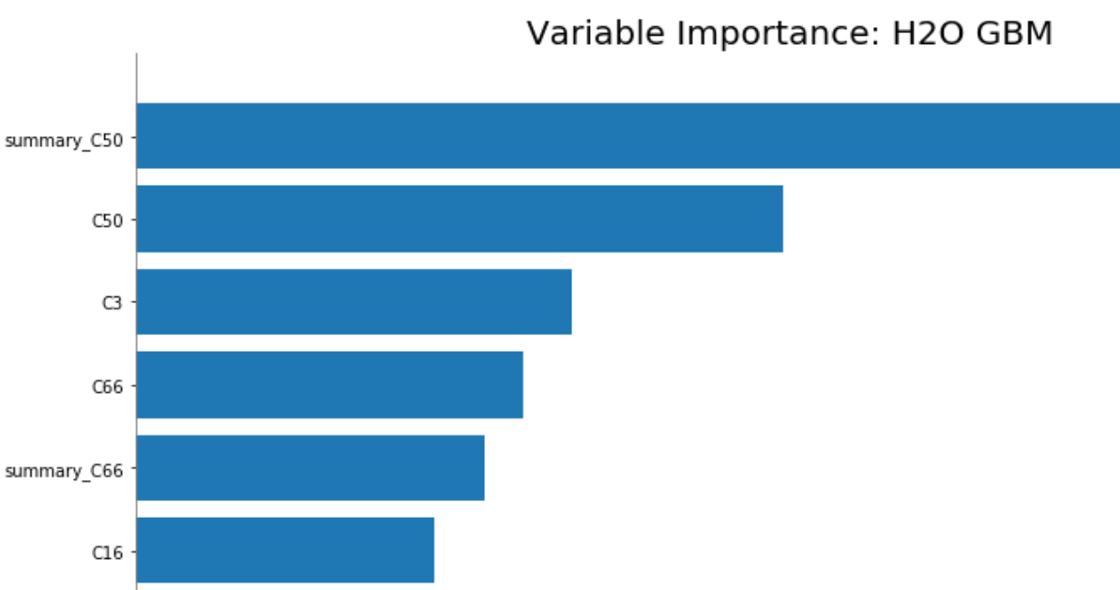
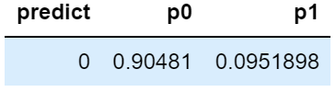
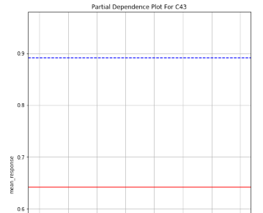
Reviews by text
(Original)
Word Process
Training
Prediction
Evaluation
Interpret/Explain
Prediction
on new
Reviews
No Reviews
Feature Importance
Train
Baseline
Model
Predict by
Baseline
Model
AUC
(0.595)
Partial Dependency Plot
(GradientBoosting)
Threshold:
>4.2 (stars)
HelpfulnessNumerator
Add Reviews,
No summary
ProductId
HelpfulnessDenominator
Tokenize
Train
Model 2
Predict by
Model 2
AUC
(0.81)
Time
Word2Vec
(GradientBoosting)
Summary_C50
C50
C3 …
Aggregate words
Reviews,
Add summary
Pos/ Neg?
Feature Importance
Word ‘guess’
Combine:
New dataset
Train
Model 3
Predict by
Model 3
AUC
(0.849)
Partial Dependency Plot
(GradientBoosting)

